Slide 1
Get Started with AI assisted PowerShell coding
Pierre Roman
@WiredCanuck
Microsoft

Slide 2

Many thanks to our sponsors:

Slide 3

Pierre Roman
Infrastructure and Operations
In the industry for 34 years
At Microsoft for 18 years
Microsoft Consulting Services
Enterprise Support Manager
Engineering / Advocacy
…..

Slide 4

Pierre Roman
@WiredCanuck
Senior Cloud Advocate at Microsoft.
He engages with the operations and infrastructure communities on behalf of Microsoft. His role is to listen to the concerns of the communities and bring that information back to the Azure Engineering Team in order to improve the platform

Slide 5


Slide 6

A.I.
ALL THE
THINGS!

Slide 7

A.I. Pair coder will make me a ninja!

Slide 8


Slide 9
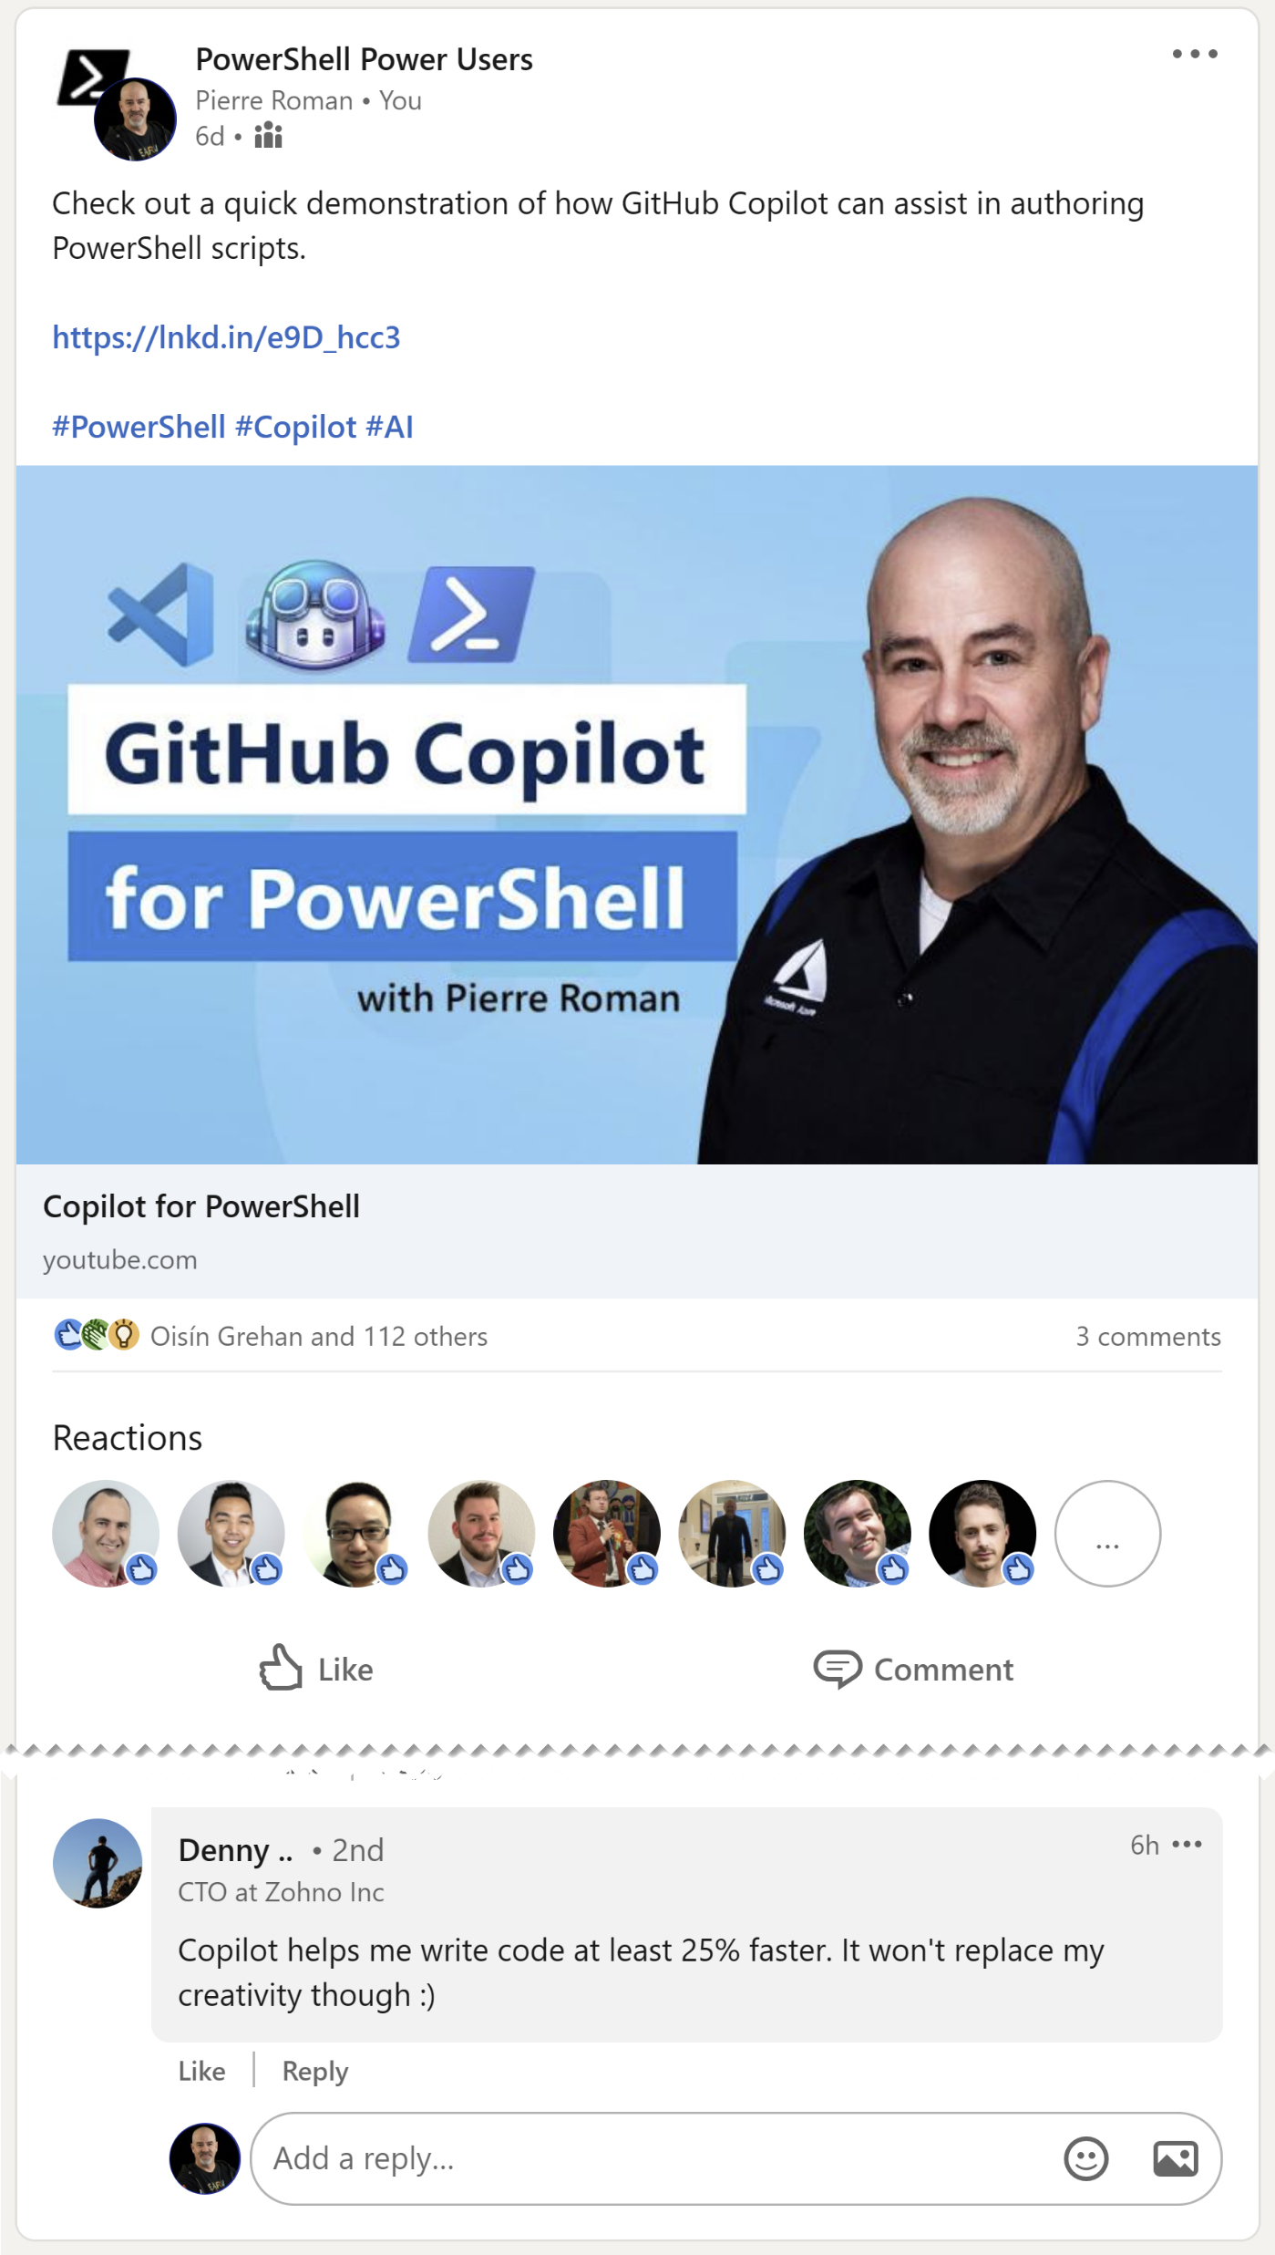
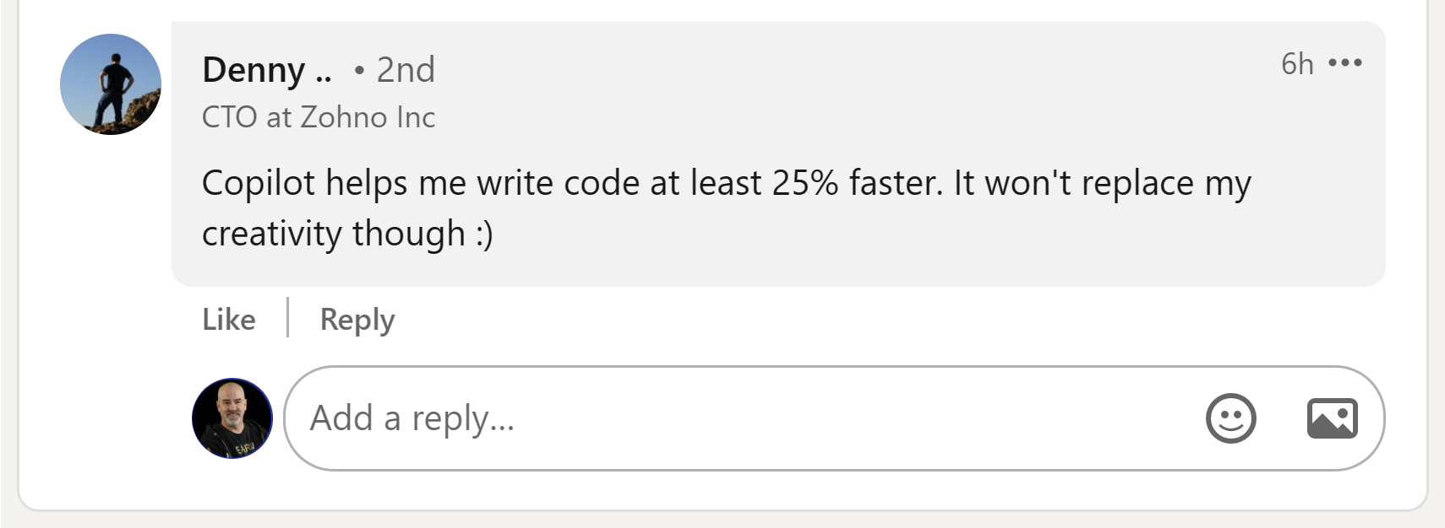

Slide 11
Artificial Intelligence
Artificial Intelligence
the field of computer science that seeks to create intelligent machines that can replicate or exceed human intelligence
1956
Machine Learning
Machine Learning
subset of AI that enables machines to learn from existing data and improve upon that data to make decisions or predictions
1997
Deep Learning
Deep Learning
a machine learning technique in which layers of neural networks are used to process data and make decisions
2017
Generative AI
Create new written, visual, and auditory content given prompts or existing data.
Generative AI
2021

Slide 12

GitHub Copilot runs on OpenAI Codex Model

Slide 13
The most important part of any A.I. generated suggestion is…

Slide 14


Slide 15
Live Coding Demo

Slide 16
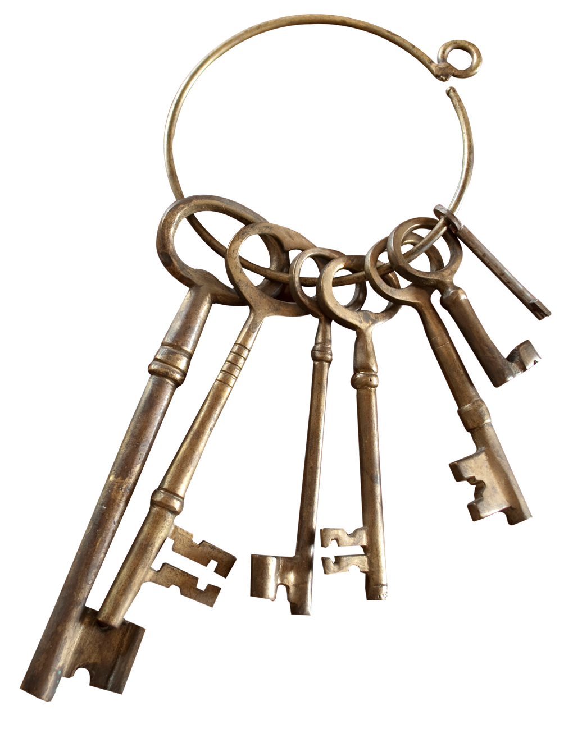
Ownership

Slide 17

Restrict Public Code
GitHub Copilot has a filter to detect code suggestions matching public code on GitHub.
The filter can be enabled or disabled.
When enabled, Copilot checks suggestions against public code within about 150 characters.
Suggestions that match or are near matches to public code will not be shown.
This helps ensure that Copilot is not suggesting code that already exists publicly.

Slide 18
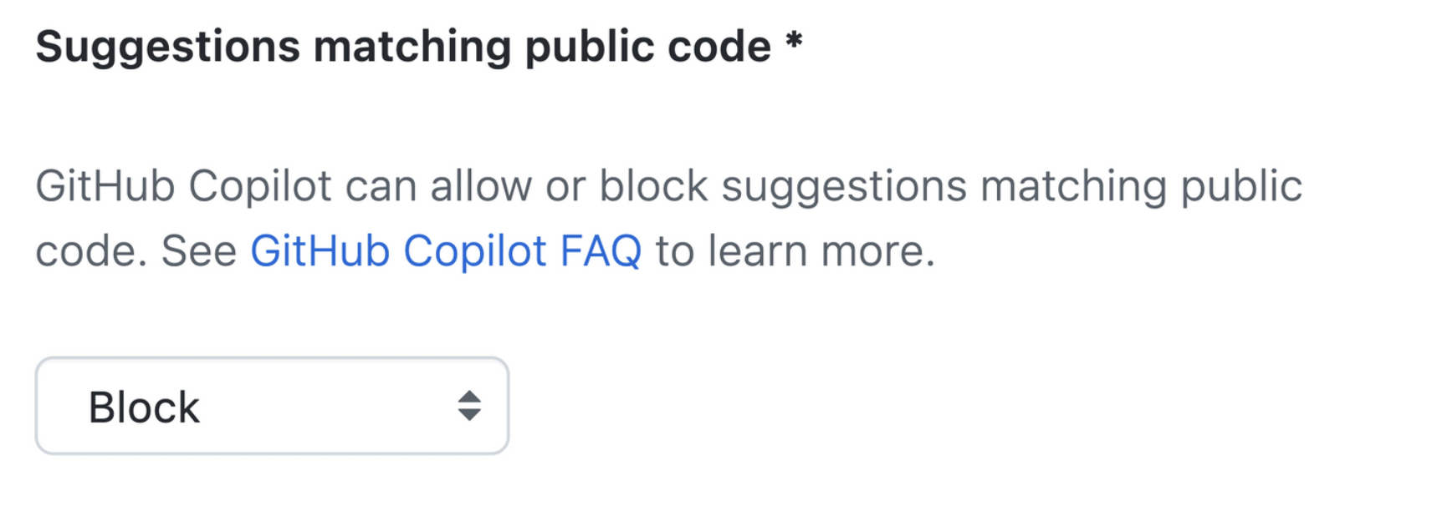
GitHub Copilot
Block
public code suggestions

Slide 19


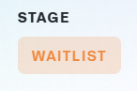
Copilot Availability
GitHub Copilot → Generally Available
GitHub Copilot Labs → Generally Available
Experimental features for GitHub Copilot
GitHub Copilot CLI → Private Preview

Slide 20


Slide 21

Thank You
Pierre Roman
Senior Cloud Advocate | Microsoft
@WiredCanuck

